Slide 1
Knowing and Reaching our Audiences
Ally Kohler
29 September 2012

Slide 2
Welcome and Introduction
1. Context for the presentations today and link to site visits yesturday
2. What is our offer/ What are we selling?
3. Who are our audiences?
4. How do we reach our audiences?
5. Are there new opportunities and can we better join up?
Notes:
My pet project but then shared that maybe I need a new one, but I will pose some questions anyway for us to consider and also to sher an good practice from elsewhere.

Slide 3
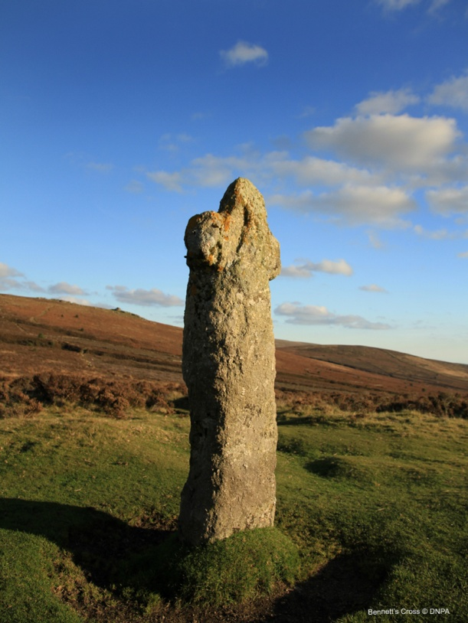
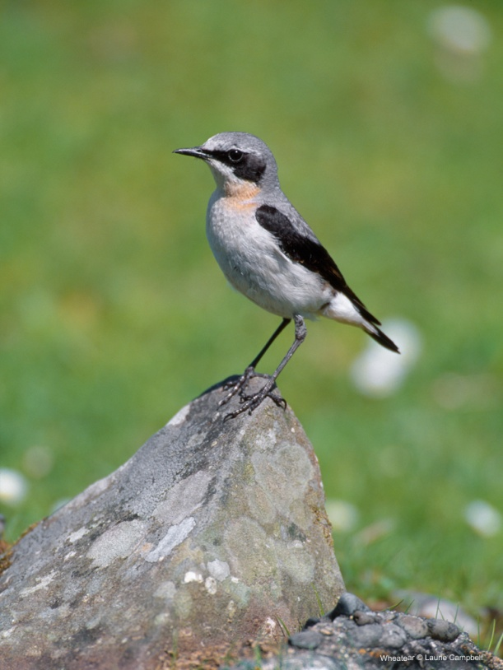
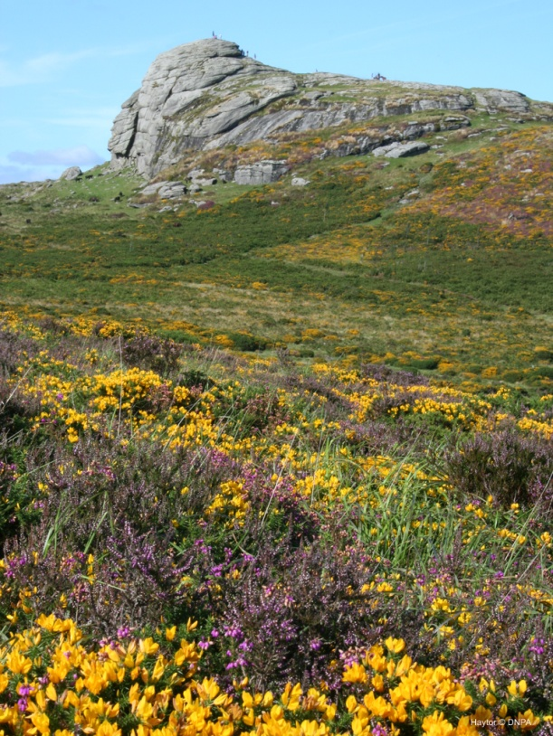
What is our offer?
Landscape, archaeology, wildlife, historic environment. Our special qualities.
Notes:
As a NP

Slide 4
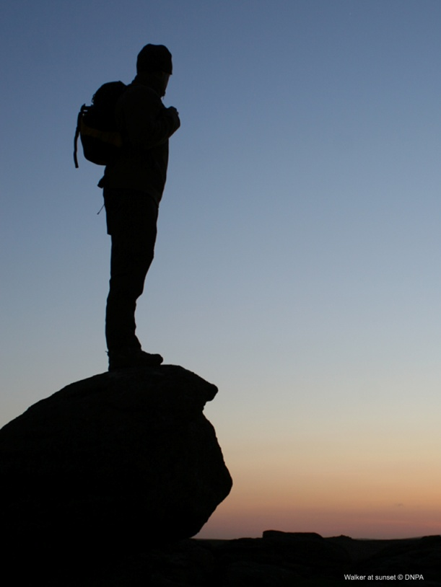
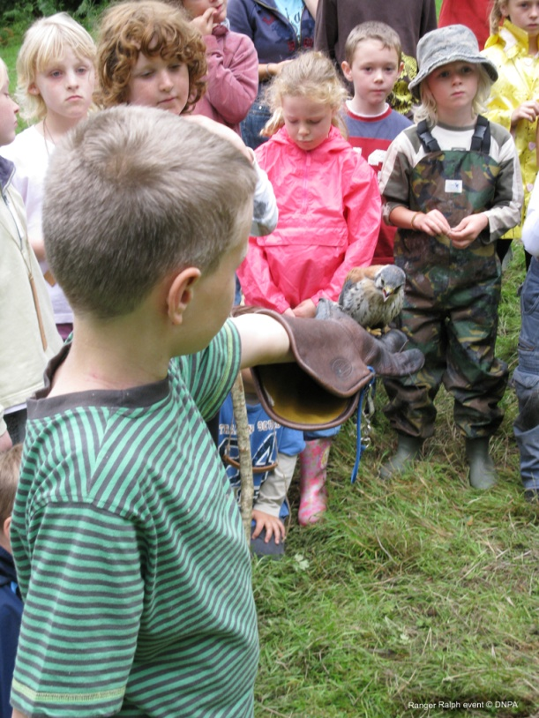
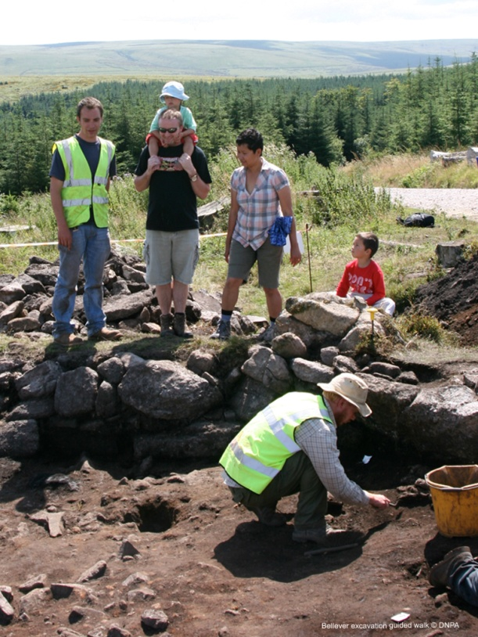
What do we offer?
Tranquility, learning, exploration, close to nature. Enjoyment and understanding
Notes:
Nearing 2,500 volunteer days

Slide 5
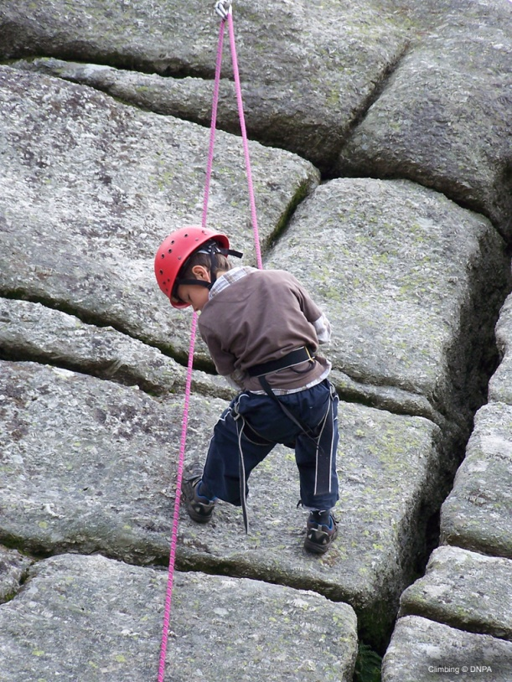
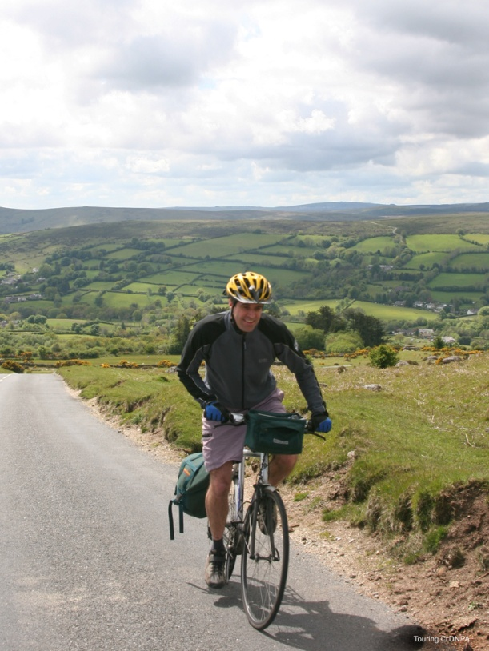
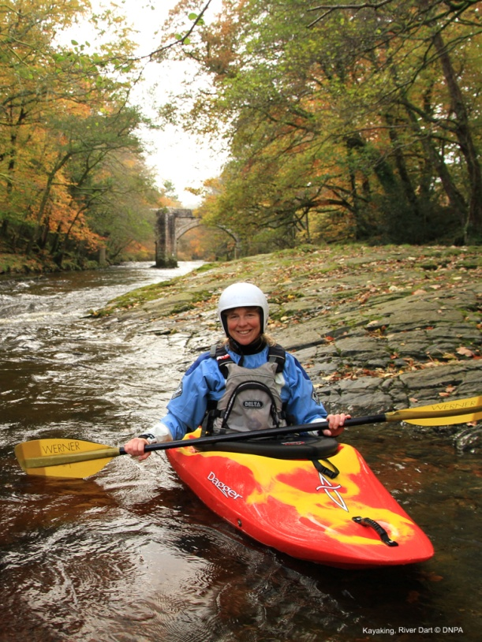
What do we offer
Adventure and exercise. Over 700km PROW 47,000 hectares access land.

Slide 6
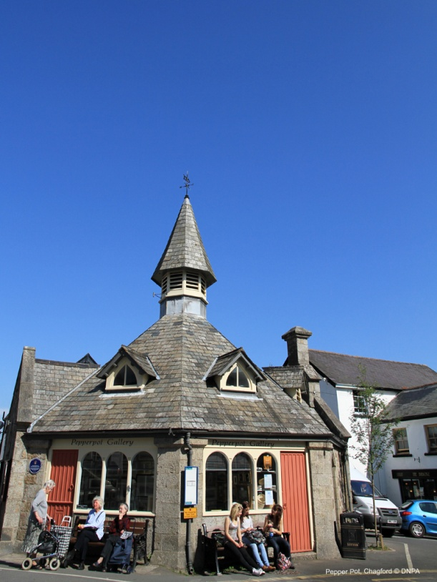
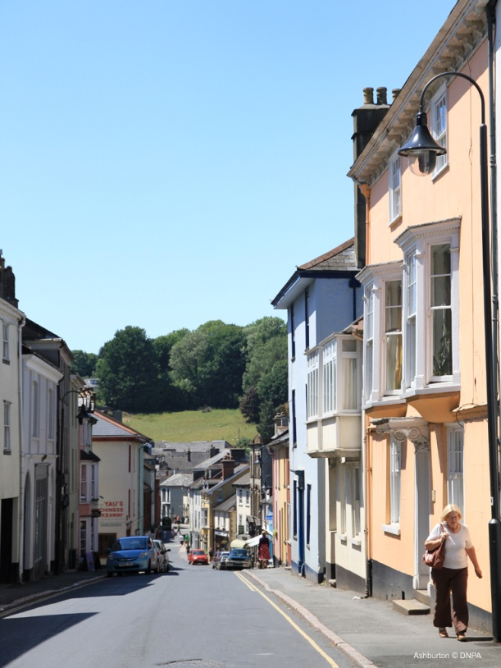
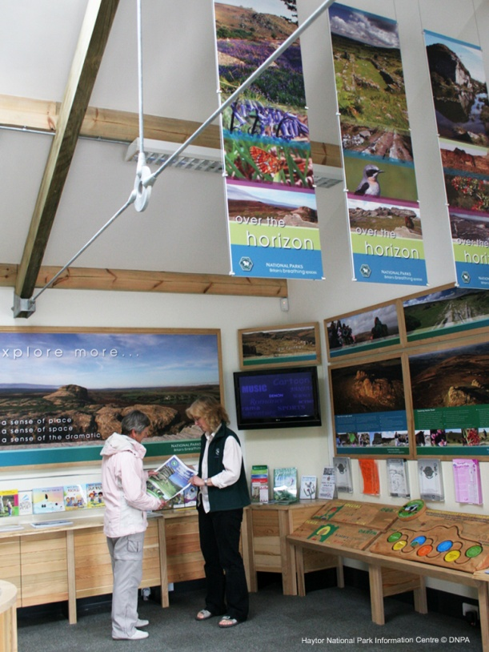
What do we offer?
Towns and villages, information and advice

Slide 7
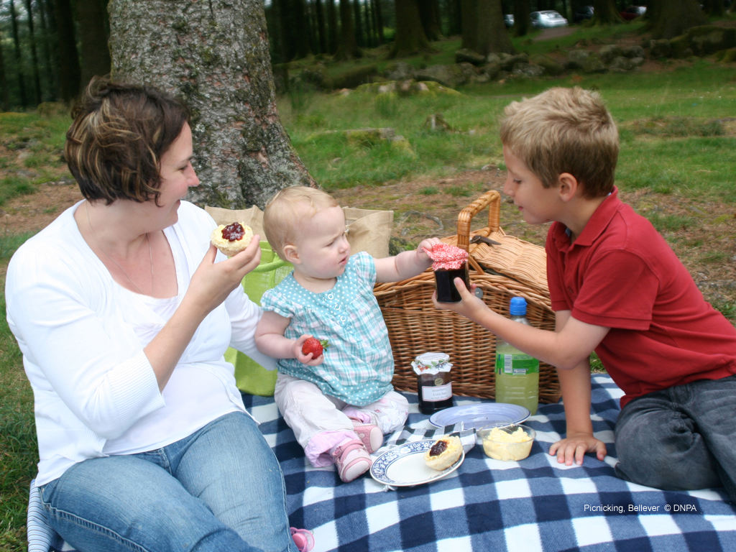
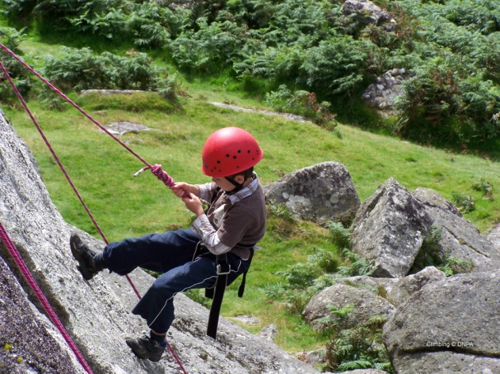
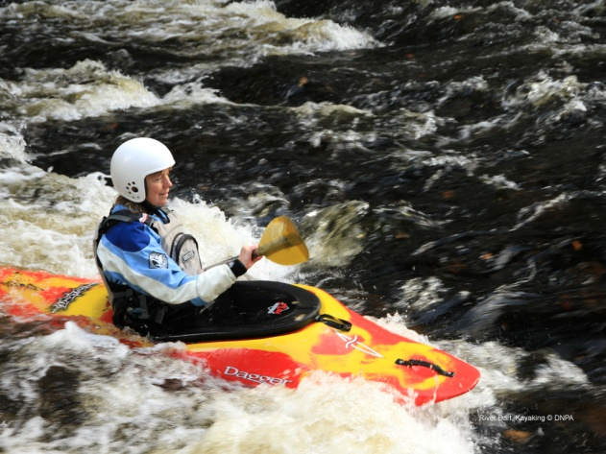
Our Audiences
People enjoying Dartmoor – people who live or already visit the area.

Slide 8
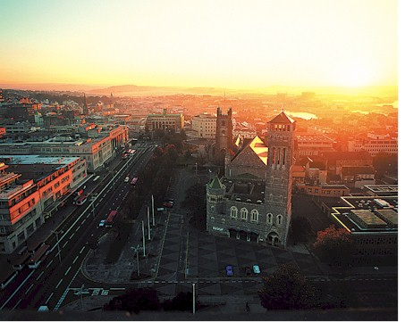
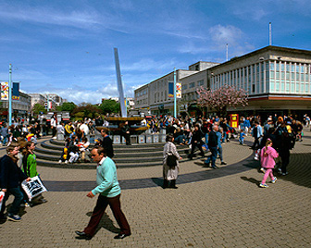
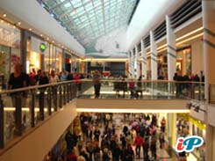
Our Audiences
People living in towns and cities nearby?

Slide 9
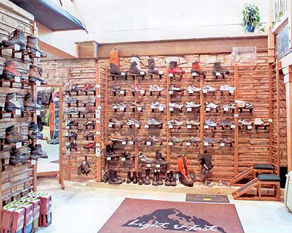
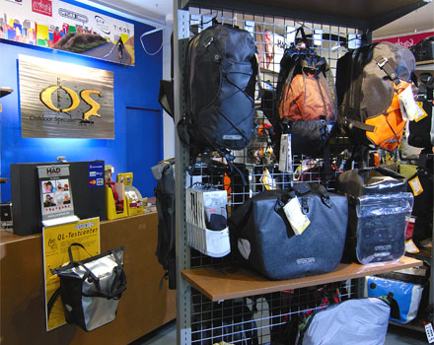
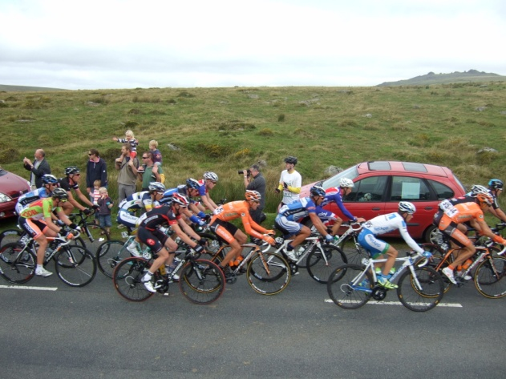
Our Audiences
Outdoor enthusiasts in lots of sports. Walking, camping, cycling, canoeing, climbing etc. People who love nature.

Slide 10
What do we want to achieve?
Encourage and help people to enjoy and understand our NP (or AONB, or coastline, or country park etc). Spend money!
Our bit of countryside.
But…. collectively we want everybody to have the opportunity to enjoy the countryside if they want to!
Notes:
(Days out not holidays)

Slide 11
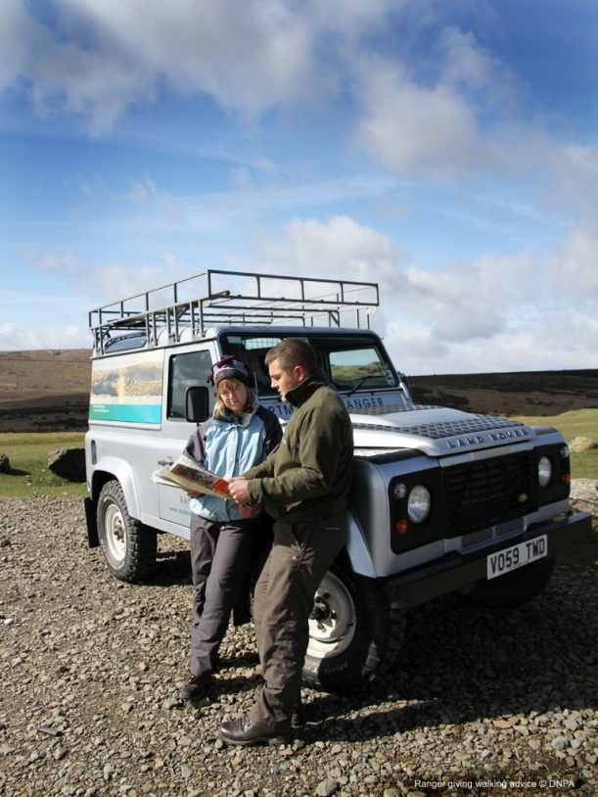
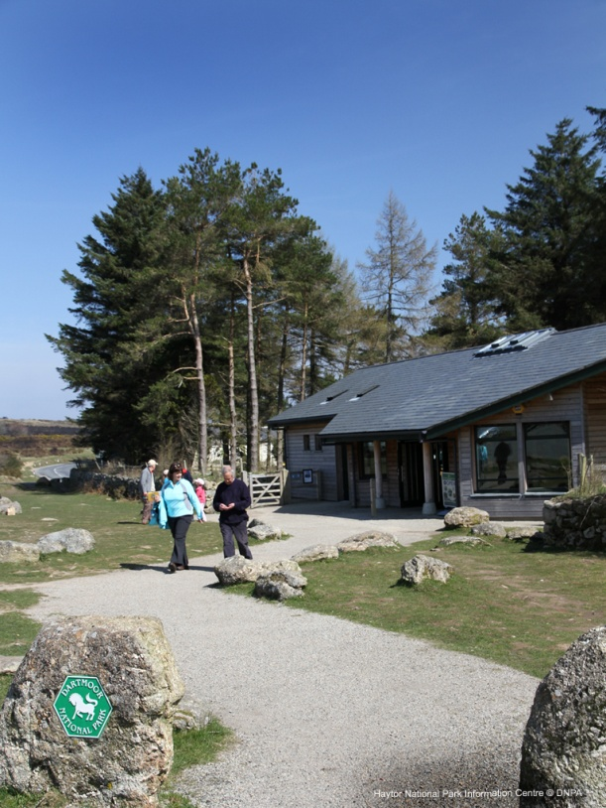

Reaching our Audiences
Rangers, information centres, publications , websites, events and activities

Slide 12
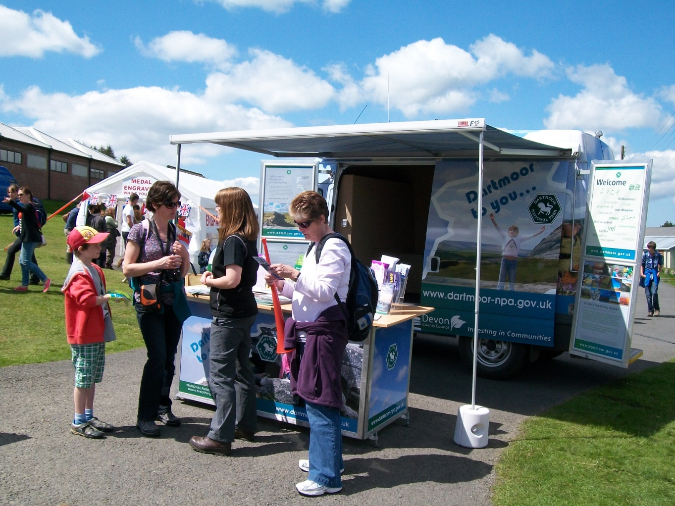
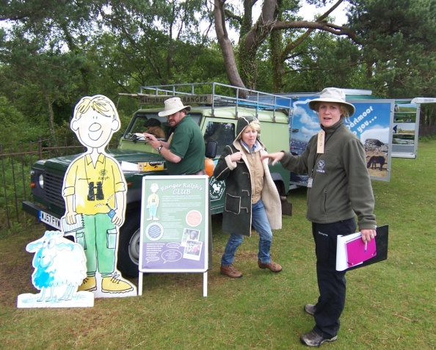
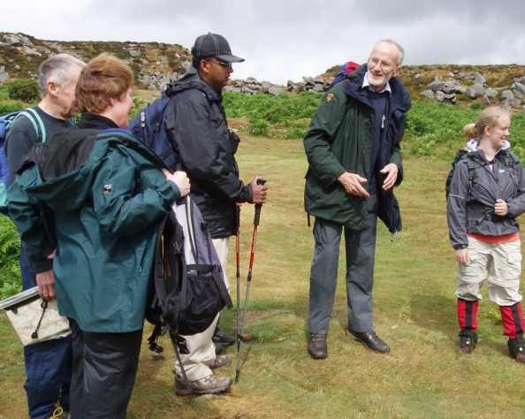
Reaching our audience
Ranger Ralph Club, Guided Walks, Moor to You – outreach vehicle
Notes:
Rr club 250 members . Outreach vehicle - 30 guided walks 300 people

Slide 13
Are we always effective?
Individually?
Collectively as a countryside resource?

Slide 14
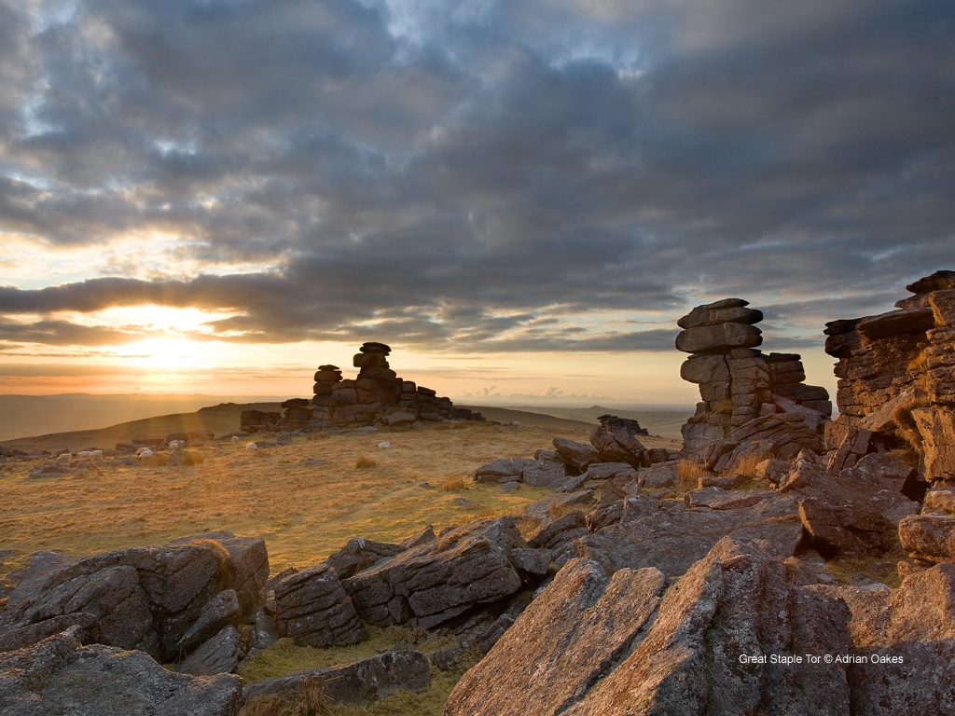

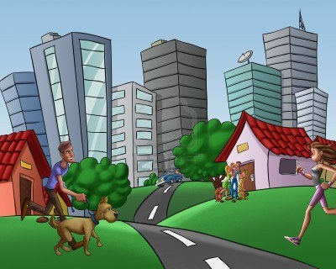
Where do we start?
Is there a tendency to focus on the place not the people
… or the destination not the starting point?

Slide 15
Targeted marketing
Place and people :
Events and activities with clear target market and established lines of communication
- Moor Wool, Ranger Ralph, Heritage Open Days, Haytor Hoppa
Specialist groups – through networks and associations, clubs, websites and magazines e.g canoe discussion yesterday
MOSAIC
Notes:
Marketting not always a welcome workd when used by NPA’s and probably other c/side agencies although things are changing. Right information to right people at right time and place – to achieve an outcome.

Slide 16



Joining up?
Reaching groups within a geographic area – are we giving a clear message not 5 or 6

Slide 17
Opportunities
Bovey Tracey/ Newton Abbot – DNPA/WT/NE/DWT all have sites and events being promoted
Plymouth – what are the opportunities
(Stepping Stones - will hear more about that )
Moor than meets the eye
Notes:
Why did DNPA get involved with this initaitive?

Slide 18
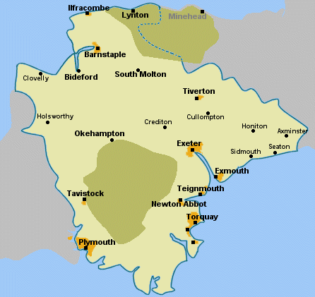
What might it look like?
Days out from Exeter – your choices – what is the overall offer and which best fits your needs?
RSPB sites, AONB, DWT,WT all partners in one product. The starting point is where people live not where they are going to !

Slide 19
Is there wider potential?
Special Interest Groups to special places
Canoeists
Cyclists
Walkers
Or do we already do that?
Notes:
One clear message?

Slide 20
Thank you for listening

